Slide 1

CEIR Block / Unblock Feature -Training Manual

Slide 2

Agenda
Feature
Stakeholder
State Diagram
UI Walk Thru
View All Block / Unblock Devices
View A Block/Unblock Device
Report Block Device for Single/Bulk
Report UnBlock Device for Single/Bulk
Withdraw Block/unblock Request
Edit Block/Unlblock Request
Approve Block/Unblock Request
Reject Block/Unblock Request

Slide 3


Feature Overview
Block/Unblock Feature allows SIM based Mobile Operator to mark SIM based devices as blocked on CEIR system. Operator may wish to mark device as blocked for subscription contract violation cases
Once the subscription contract issue are resolved , the same is marked as unblocked on CEIR system
Typical flow is as follows:
Block
End user violate mobile subscription with an operator
Operator wish to block such devices in the CEIR system
Operator mark device as blocked using CEIR portal
CEIR Admin approve the request
Unblock
End user resolve the mobile subscription contract with an operator
Operator wish to unblock such devices in the CEIR system
Operator mark device as unblocked using CEIR portal
CEIR Admin approve the request
Single User
Bulk User
Operator like Smart, QB etc
CEIR System

Slide 4
Feature Impact / Use Cases
Importance of this feature for the CEIR System
Operator would welcome this feedback, as this allow operator to block the devices in other operator network within Cambodia.
Basis of this block feature, local black list is created. Grey list would be created from this local black list
Grey list is converted into black list if the issue is not resolved in the predefined time by user
Local Black list DB becomes one of the policy DB on which rule are applied. For eg, if the user does the Check IMEI for this devices, it would be shown as invalid.

Slide 5
Stakeholder Overview
S.No. | User | Key Feature
1 | Operator | Mark Device as Block/ Unblock
2 | Operations | Mark Device as Block/Unblock
3 | CEIR Admin | Approve/Reject block/ unblock request
CEIR Admin can also block /unblock the devices on special request.

Slide 6
State Transition – Overview - Block
Operator
System
CEIR Admin
Approved
Block Request State under various Stakeholder
NEW
PROCESSING
Pending for CEIR Approval
Report for
Blocking
System
Process
System
Process
Approve
System
Process
Edit
Reject
Rejected by System
Edit by Operator
Rejected by
CEIR Admin
Device State under various Stakeholder
INIT
Pending
Blocked

Slide 7
State Transition – Overview - Unblock
Operator
System
CEIR Admin
Approved
Stolen Request State under various Stakeholder
NEW
PROCESSING
Pending for CEIR Approval
Report for
unblocking
System
Process
System
Process
Approve
System
Process
Edit
Reject
Rejected by System
Edit by Operator
Rejected by
CEIR Admin
Device State under various Stakeholder
Blocked
Pending
Active

Slide 8
State Transition - Overview
State | Meaning
New | Operator has mark one or more devices as block/unblock
Processing | The system has started the processing of this request
Rejected by system | The system has found an error, most likely in the file format, file data, file size, policy-based errors
Pending approval from CEIR Admin | The file processing is successful, stolen request is accepted and now it is sent to CEIR Admin for approval
Rejected by CEIR Admin | CEIR Admin has rejected the request
Approved | CEIR Admin has approved the request
Withdrawn by Operator | Operator has withdrawn the request.
Withdrawn by CEIR | CEIR Admin has withdrawn the request.

Slide 9
UI – Overview - Feature
S.No. | Feature | Stakeholder
1 | View all block/unblock devices request | Operator, Operations, CEIR Admin
2 | View a block/unblock request | Operator, Operations, CEIR Admin
3 | Approve block/unblock Request | CEIR Admin
4 | Reject block/unblock Request | CEIR Admin, System
5 | Edit | Operator, Operations, CEIR Admin
6 | Delete (Withdraw) | Operator, Operations, CEIR Admin
7 | View | Operator, Operations, CEIR Admin
8 | History | Operator, Operations, CEIR Admin

Slide 10
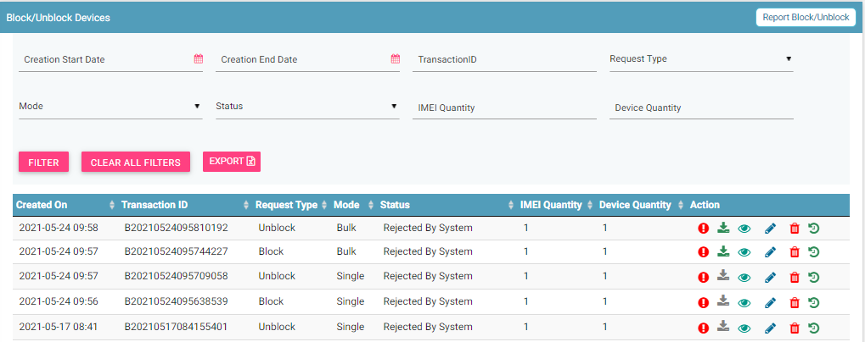
View All Block/Unblock Request
Report Block/ Unblock
Filters
Export
Action like View, Delete
View All Request

Slide 11
Action List
Action are enabled / disabled based on the state of the request.

Slide 12
Actions Enabled/ Disabled for Mobile Operator

Slide 13
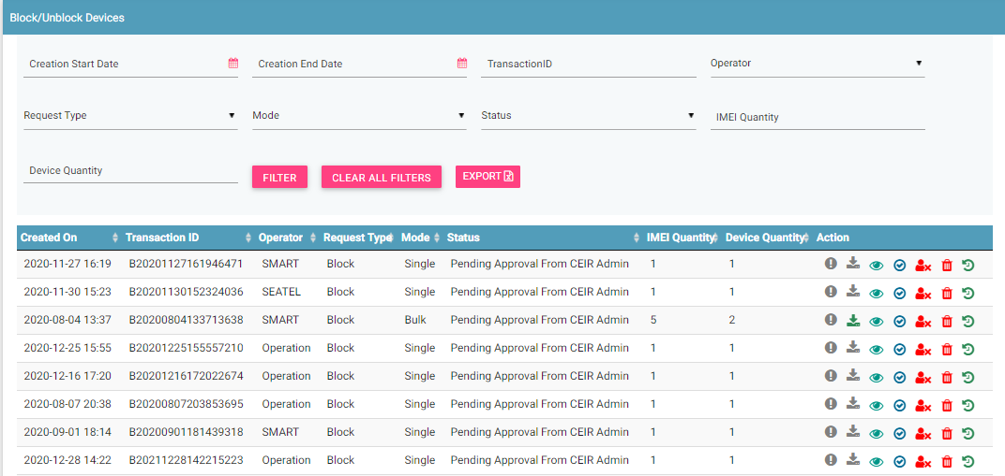
CEIR Admin Portal
By default, request with status “Pending approval from CEIR Admin” will be displayed in the CEIR Admin queue.
In case CEIR Admin wishes to view block/unblock request in any other state, they can use the filter options to display the same.

Slide 14
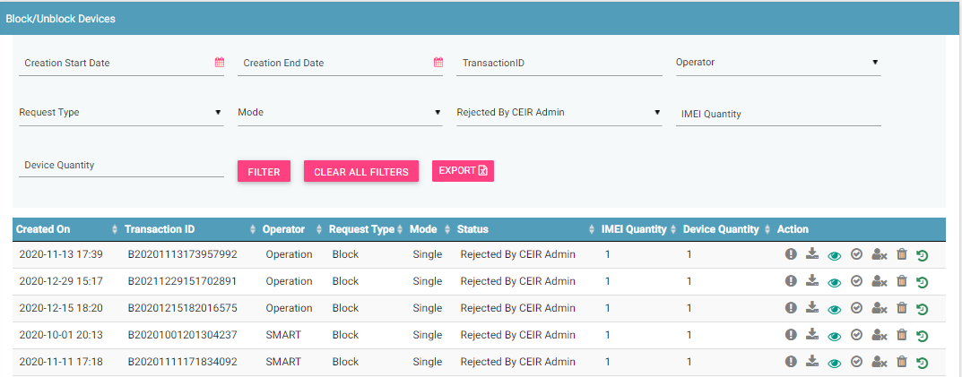
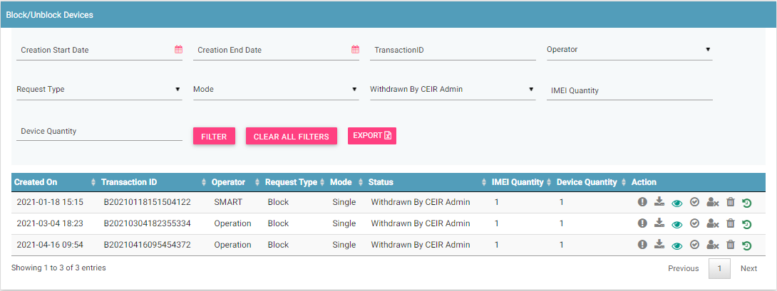
CEIR Admin Portal (contd.)
For request status as PENDING APPROVAL FROM CEIR ADMIN, actions like View, Approve, Reject and Withdraw all will be enabled for CEIR Admin.
For request status as REJECTED BY CEIR ADMIN , actions like View, Approve and Withdraw will be enabled for CEIR Admin.
For request status as WITHDRAWN BY CEIR ADMIN, only View option will be enabled for CEIR Admin.
All other states will have only View option enabled for CEIR Admin.

Slide 15
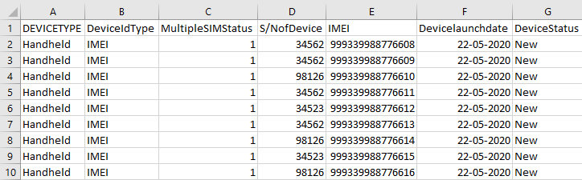
Block/Unblock Flow
Mobile Operator want to block/unblock a device .
In order to mark device as blocked, a Mobile Operator needs to furnish the following details:
Device Information including mobile numbr, operator, device IMEI (Optional),
A unique Transaction ID is generated for each new request which is registered. This transaction id can be used in future for raising grievance (if any) regarding the request. The transaction ID will be used for tracking the reqeust at any state.
System processing is being done at the backend. Status = PROCESSING
In case the request is rejected by system. Status = REJECTED BY SYSTEM
System rejects the request in case there is some issue with the format of the file uploaded or any policy violation is done. The format of the file is available for download on the view all screen.

Slide 16
Block / Unblock Flow ( contd..)
After successful internal processing, the request is sent to the CEIR Admin queue for Approval/ Rejection. Status = PENDING APPROVAL FROM CEIR ADMIN.
CEIR Admin rejects the request. Status = REJECTED BY CEIR ADMIN. Email is sent to Mobile Operator and CEIR Admin. Notifications is also displayed on the Mobile Operator dashboard.
CEIR Admin can also withdraw request. Status = WITHDRAWN BY CEIR. This can be done in scenarios like Mobile Operator has wrongly marked as device stolen and some other end user has rightly claimed the device.
CEIR Authority approves the request. Status = APPROVED. Email is sent to Mobile Operator. Notifications are also displayed on the Mobile Operator and CEIR Admin dashboard.
Mobile Operator can also withdraw request when it is in either NEW/ REJECTED BY SYSTEM state. Status = WITHDRAWN BY OPERATOR

Slide 17
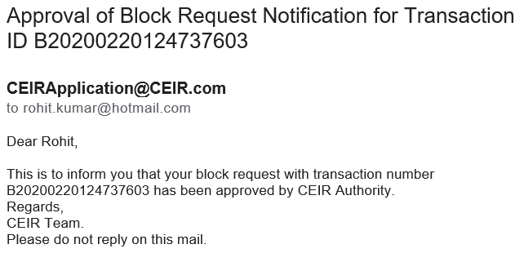
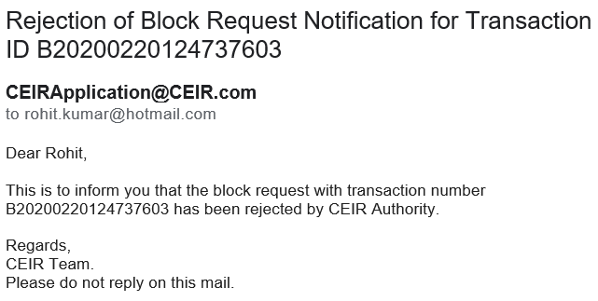
Email samples
Approved by CEIR
Rejected by CEIR
Email contents can be configured from the System Admin portal. This will be explained in detail in the system configuration training.

Slide 18
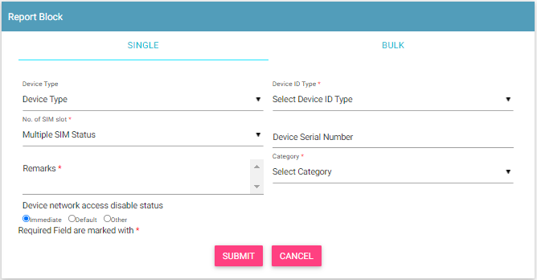
Report Block Device – Single
Some Rules to Follow
Mobile Operator will ensure the device ownership and user ID to validate that correct device is being blocked

Slide 19
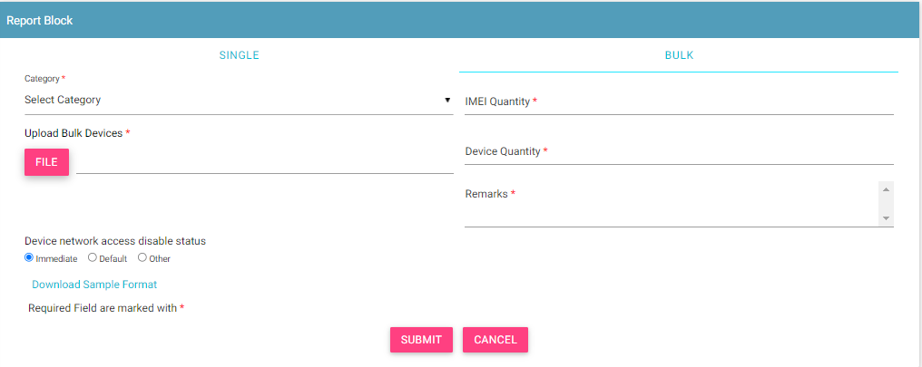
Report Block Device – Bulk
Some Rules to Follow
Mobile Operator will ensure the device ownership and user ID to validate that correct device is being blocked

Slide 20
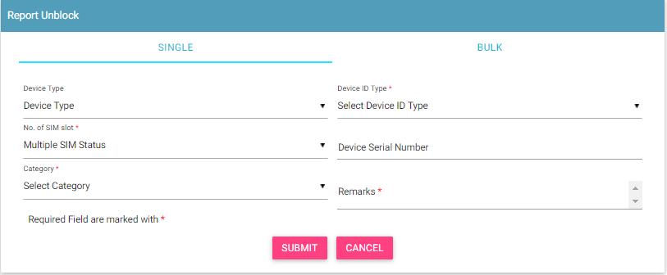
Report Un-Block Device – Single
Some Rules to Follow
Mobile Operator will ensure the device ownership and user ID to validate that correct device is being blocked

Slide 21
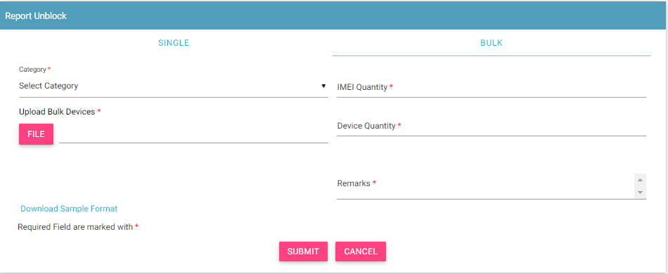
Report Un-Block Device – Bulk
Some Rules to Follow
Mobile Operator will ensure the device ownership and user ID to validate that correct device is being blocked

Slide 22
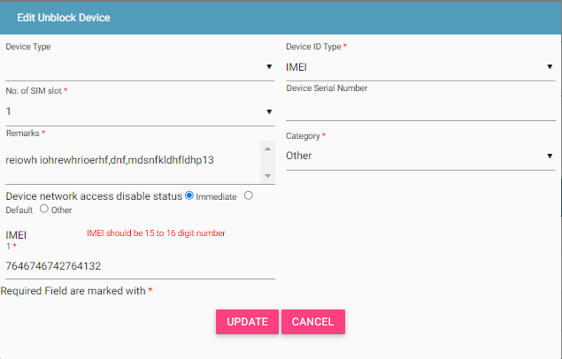
Edit Block/ Unblock Request
Only allowed in rejected states
Rejected By System
Rejected By CEIR Admin
Edit By Mobile Operator/CEIR Admin
NEW
What is Editable
Fields in the form
File that was initially uploaded.
Request moved back to NEW state

Slide 23
Special Case – Priority Blocking
User can define time when the device should be marked in black list
There are 3 monitoring period possible
Monitoring Period | Description
Immediate | The device will be blocked immediately.
Default | The device will be blocked as per period defined in the policy definition
Later | The device will be blocked as per date provided by user

Slide 24
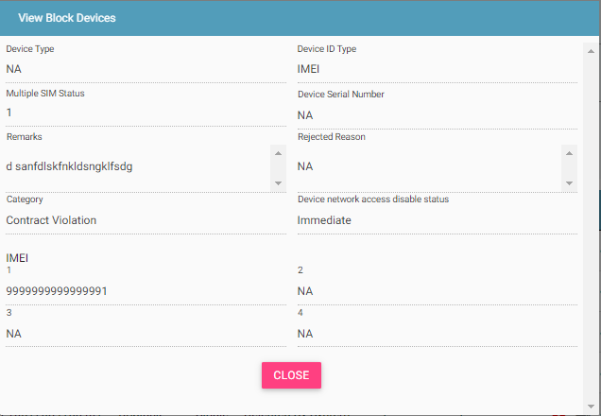
View Block / Unblock Request
Who all can view the block/unblock request?
Mobile Operator
Operations
CEIR Admin
This screen is not editable. This is just to view the details filled in by the Operator.

Slide 25
System Processing
All NEW request will be processed in FIFO order by the system
Once the processing starts, the status is changed to PROCESSING to indicate that Work is in progress
Once the processing is complete, the status is changed to either REJECTED_BY_SYSTEM or SUCCESS (PENDING_APPROVAL_FROM_CEIR_ADMIN)
Post processing an e-mail notification is sent to Mobile Operator in case of REJECTED_BY_SYSTEM and in case of SUCCESS email is sent to both Mobile Operator and CEIR Admin.

Slide 26
System Processing – Block Case
If all the policy has passed for block request, then the IMEI is added in the grey list
If all the policy has passed for unblock request, then the IMEI is removed from the grey/black list as applicable

Slide 27
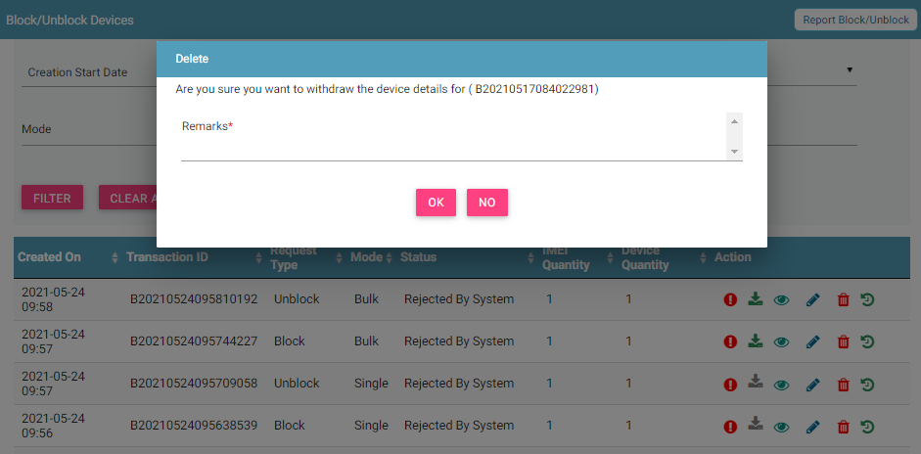
Block/Unblock Request Withdrawn By Mobile Operator
Mobile Operator can withdraw block and unblock request in two states only
New
Rejected by System

Slide 28
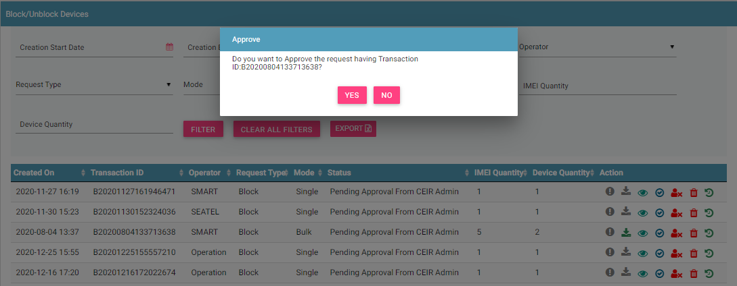
Request Approved by CEIR Admin
Request after successful processing are sent to the CEIR Admin queue for Approval / Rejection.
On Rejection, request are sent back to the Mobile Operator queue.

Slide 29
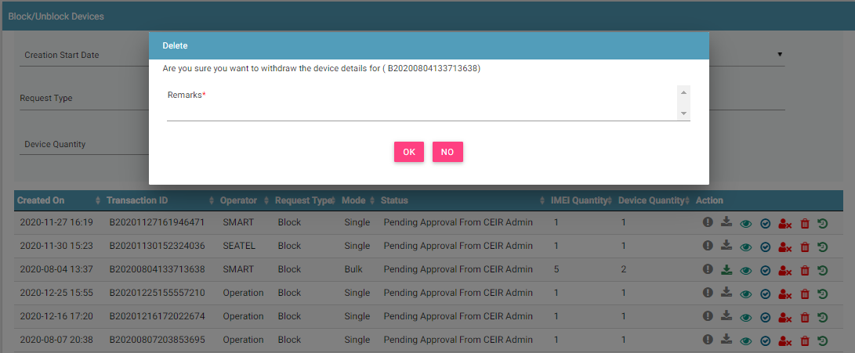
Request Rejected by CEIR Admin
CEIR Admin has the authority to reject any request. Remarks have to be updated for the same.

Slide 30
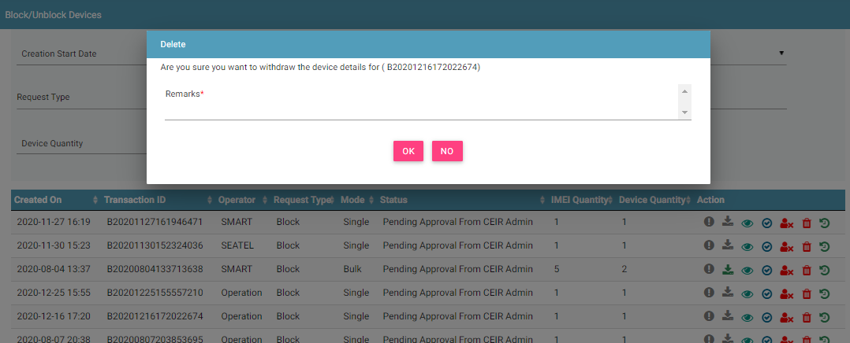
Request Withdrawn By CEIR Admin
CEIR Admin has the authority to withdraw any request. Remarks have to be updated for the same.

Slide 31
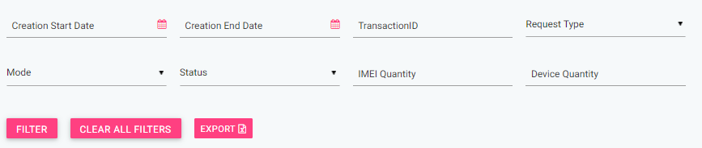
Filter Block/unblock Request
Request can be filtered on the basis of
Date filters, Transaction ID, Request Status
Request Type (Block/Unblock)
Request Mode (Single/Bulk)
User ( Mobile Operator/ CEIR Admin) can also use a combination of more than one filters to filter the consignments.
Users can view old request using the date filter.
Clear All Filters can be used to clear filters and refresh the data table.
Export button will export the data based on the filters applied.

Slide 32
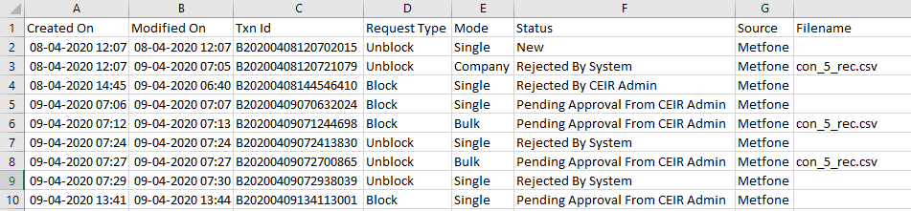
Export Block/Unblock Request
Requests can be exported in a .csv file using the export button.
User can export all request assigned to the respective user.
User can export filtered requesst.

Slide 33
Sorting of data
By default, the data displayed is sorted in descending order on last modified date.
Data can be sorted based on other fields by clicking the arrow buttons on the column headers. On first click, data will be sorted in ascending order. On second click, it will be sorted in descending order.

Slide 34
Policy
Policy for grace and post grace period will be same for reporting block/unblock devices
Only device marked as blocked can be marked as unblocked on the system
More details on same would be discussed in the “Policy Management” Training session

Slide 35
Whats Next
Once the local stolen list is created in the system, the same is used to generate the grey list/file which is downloaded by operator
The grey list as per the monitoring period as mentioned by the Mobile Operator.
Post expiry of monitoring period, the number will be moved to black list

Slide 36
Scenario
Scenario | Result
Mobile Operator report device to be unblocked which is not marked as blocked | Reject the Request
Mobile Operator report device to be blocked but TAC check at GSMA has failed. | Policy Decision. It is recommended that this should not be allowed to ensure correct data in system
Mobile Operator mark device as blocked but already marked blocked before | Reject the request
Mobile Operator mark device as blocked but IMEI static validation fails (length, charset, Luhn Algorithm) | Policy Decision. It is recommended that this should not be allowed to ensure correct data in system

Slide 37
Queries

Slide 38
Thank You

